Slide 1
Captcha Analyzer
Picture to Text
Or Hasan

Slide 2
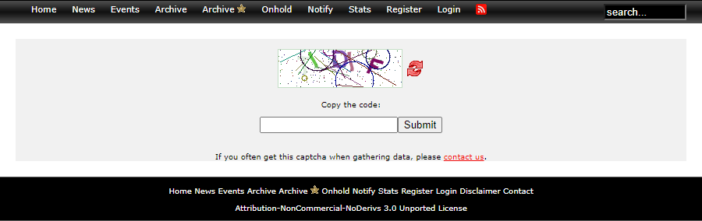
Tested Website

Slide 3

Steps
Filter Noise with Selected Method
Send to API Model*
Correct API Text Result
Check in the Site if the Result is Correct
Save Results for Future ML Improvements
Screenshot the Captcha
New
Captcha
1
2
3
Get Browser Cookies
Run Main Program
Return the ZHE & PHPSESSID to the calling program
The running program will no longer need the captcha authorization to run, even from another browser and without Selenium
* Used API: “Text Captcha Breaker”

Slide 4

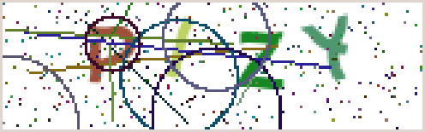


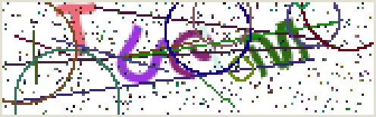


Captcha Examples
Can you read this or ARE YOU A ROBOT?

Slide 5
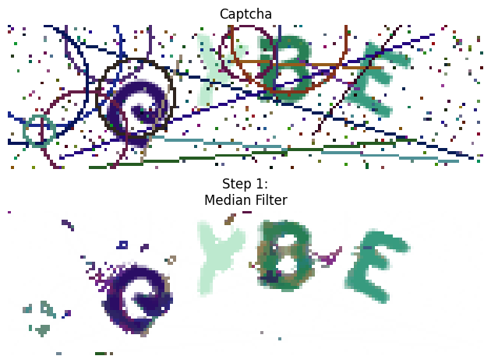
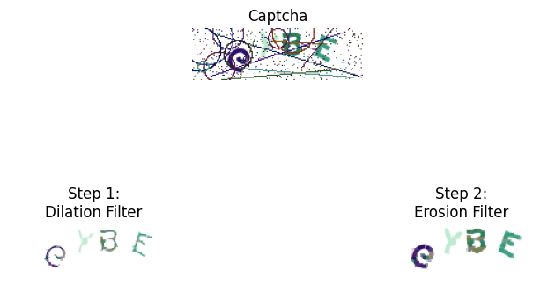



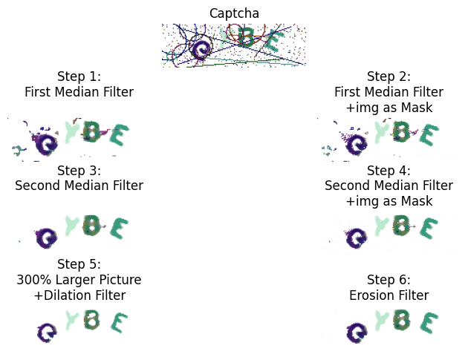
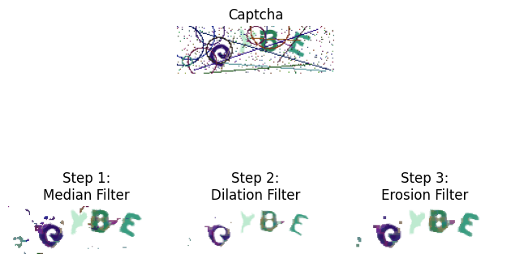
Different Methods
or
Y
X
or
P
D

Slide 6
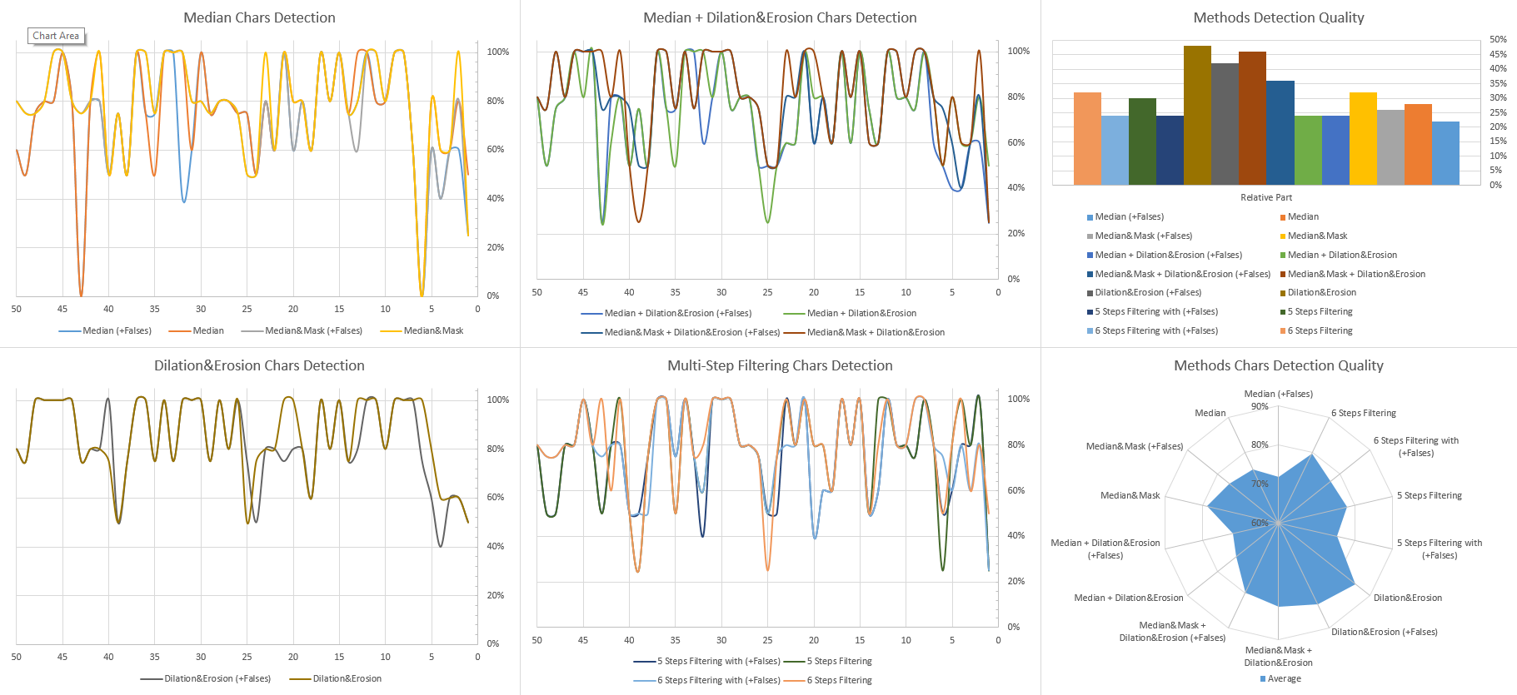

Methods Comparison

Slide 7
Methods Detection Quality
14 / 50
16 / 50
12 / 50
Median
Median&Mask
Median + Dilation&Erosion
23 / 50
24 / 50
15 / 50
Median&Mask + Dilation&Erosion
Dilation&Erosion
5 Steps Filtering
16 / 50
6 Steps Filtering

Slide 8

API Correction
Chars Conversion Table
e | C
l | I
Numbers Conversion Table
0 | O
1 | I
2 | Z
3 | B
4 | A
5 | S
6 | E
7 | X
8 | B
9 | O
Showed 6%-10% of improvement in the detection results
Example for ‘C’:

Slide 9


THANK YOU!
Or Hasan
Phone:
054-xxx-xxxx
Email:
xxxx.xx.xxxx@gmail.com
LinkedIn:
https://www.linkedin.com/in/or-hasan/

